Slide 1


Cloud Native Applications
Circuit Breakers and Fault Tolerance
Notes:
Resting slide on screen before you begin presenting.

Slide 2
Fault Tolerance
One failure must not cause a cascading failure across the entire system.
For example, for an application that depends on 30 services where each service has 99.99% uptime, here is what you can expect: 99.99^30 = 99.7% uptime 0.3% of 1 billion requests = 3,000,000 failures 2+ hours downtime/month if all dependencies have 99.99%
Reality is generally worse.
Source: https://github.com/Netflix/Hystrix/wiki
Notes:
Service Discovery is one of the key tenets of a microservice based architecture.
In distributed systems, application dependencies cease to be a method call away.
Trying to hand configure each client or use some form of convention can be very difficult to do and can be very brittle.

Slide 3
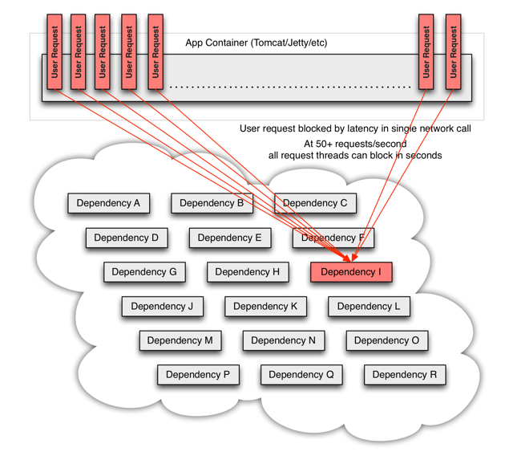
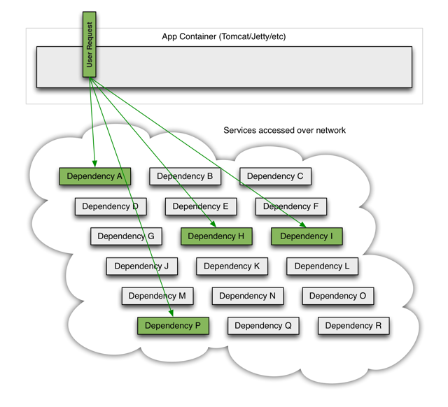
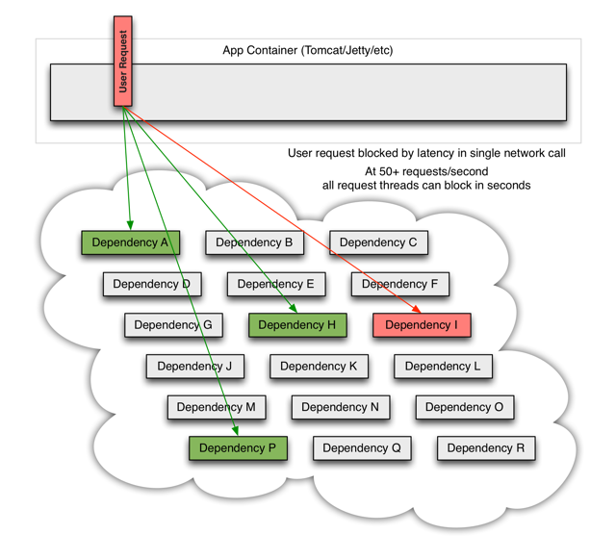
Distributed Systems Failures
Notes:
Service Discovery is one of the key tenets of a microservice based architecture.
In distributed systems, application dependencies cease to be a method call away.
Trying to hand configure each client or use some form of convention can be very difficult to do and can be very brittle.

Slide 4
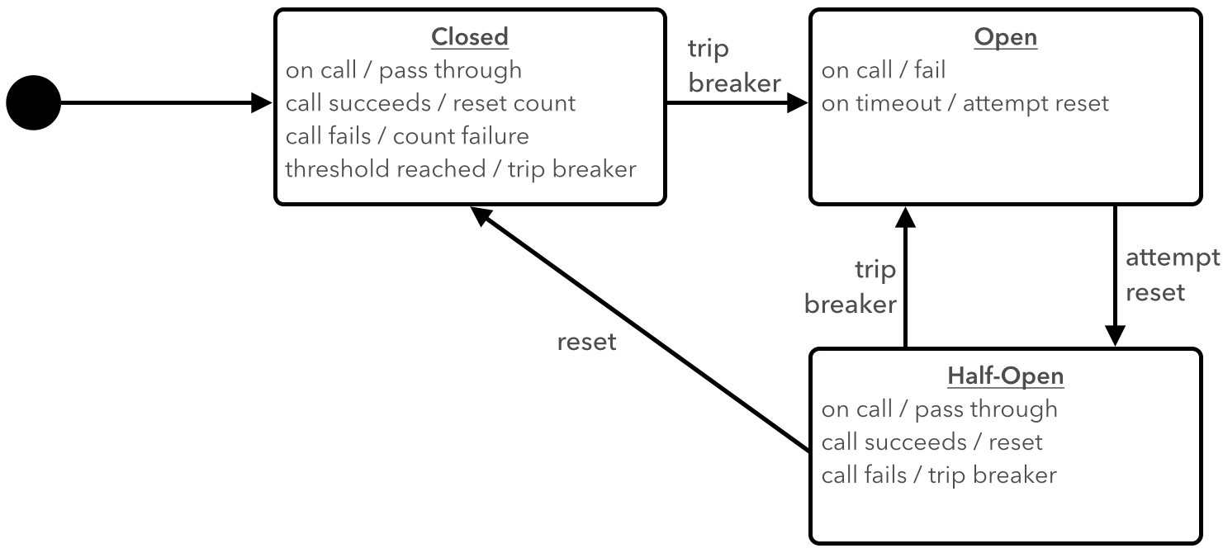
Circuit Breaker Pattern

Slide 5
Implementing Circuit Breakers
@SpringBootApplication
@EnableDiscoveryClient
@EnableCircuitBreaker
public class MyClientApp{
public static void main(String[] args) {
SpringApplication.run(MyClientApp.class, args);
}
}
MAGIC!!
<dependency>
<groupId>io.pivotal.spring.cloud</groupId>
<artifactId>spring-cloud-starter-hystrix</artifactId>
</dependency>

Slide 6
Spring Cloud Circuit Breakers
abstraction across different circuit breaker implementations
provides a consistent API for use in applications

Slide 7
Resilence4J

Slide 8
Resilence4J Metrics
Circuit Breaker status reported via Micrometer.
PCF Metrics or Wavefront can capture metrics for Dashboards.

Slide 9

Lab

